Slide 1
Estimating the Work
A Module in Agile Fundamentals
Notes:
Plan, execute and report on Agile projects
--------------------------------------------------------------------------------------------------------------------
Welcome to the module Planning the Project. This module is brought to you by ThoughtWorks Studios, maker of Mingle, Cruise, and Twist.
In this module, we’ll explore the practices that help Managers and Project Managers plan, execute, and report on Agile projects.

Slide 2
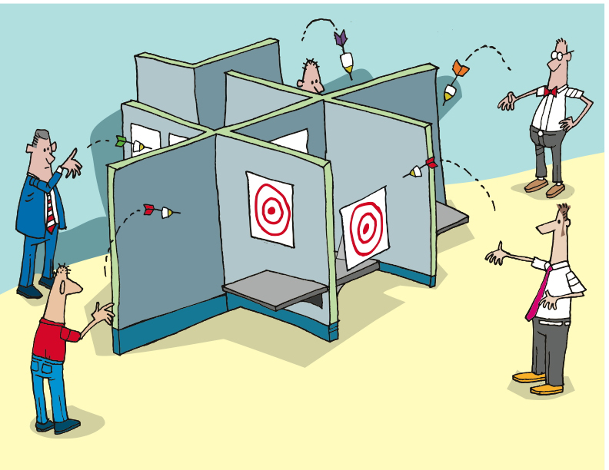
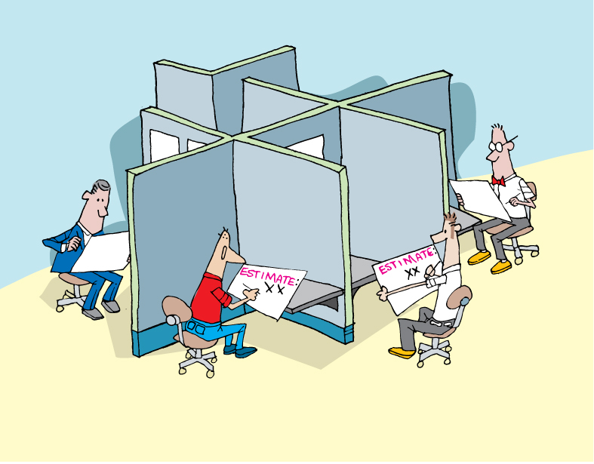
Notes:
We do not want to rely on individual estimates, certainly not from those who will not be delivering the project.
Do you do this now?

Slide 3
Estimating the Effort
Notes:
Accuracy – degree of closeness
Precision – reproducibility or repeatability
Results of calculations or measurements can be:
Accurate but not precise
Precise but not accurate
----------------------------------------------------------------------------------------------------------
Agile estimation is one of the parts that folks new to Agile struggle with. In this section, we’ll dig into the why and the how, and then give you some very specific practices.
Let’s begin with gaining an understanding of the terms “accuracy” and “precision”.
From Wikipedia, we get this definition: [CLICK]
In the fields of science, engineering, industry and statistics, accuracy is the degree of closeness of a measured or calculated quantity to its actual (true) value.
Accuracy is closely related to precision, also called reproducibility or repeatability, the degree to which further measurements or calculations show the same or similar results.
The results of calculations or a measurement can be accurate but not precise, precise but not accurate, neither, or both. A measurement system or computational method is called valid if it is both accurate and precise. The related terms are bias (non-random or directed effects caused by a factor or factors unrelated by the independent variable) and error (random variability), respectively.

Slide 4


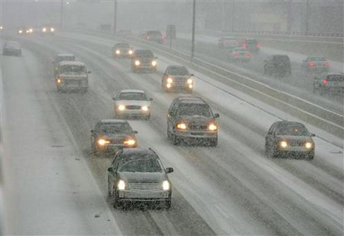
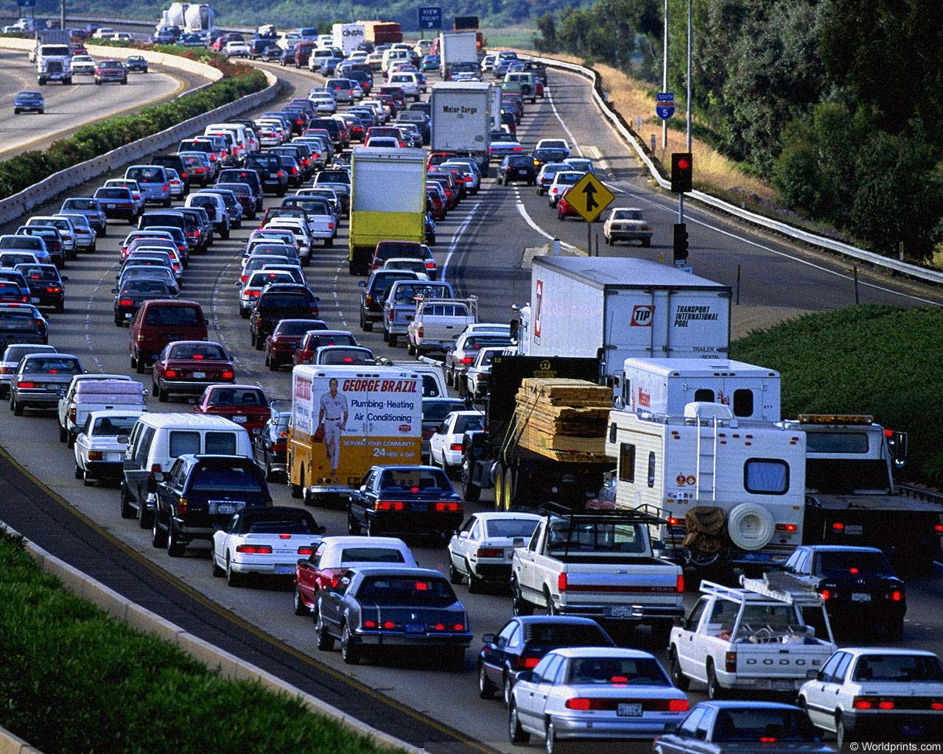
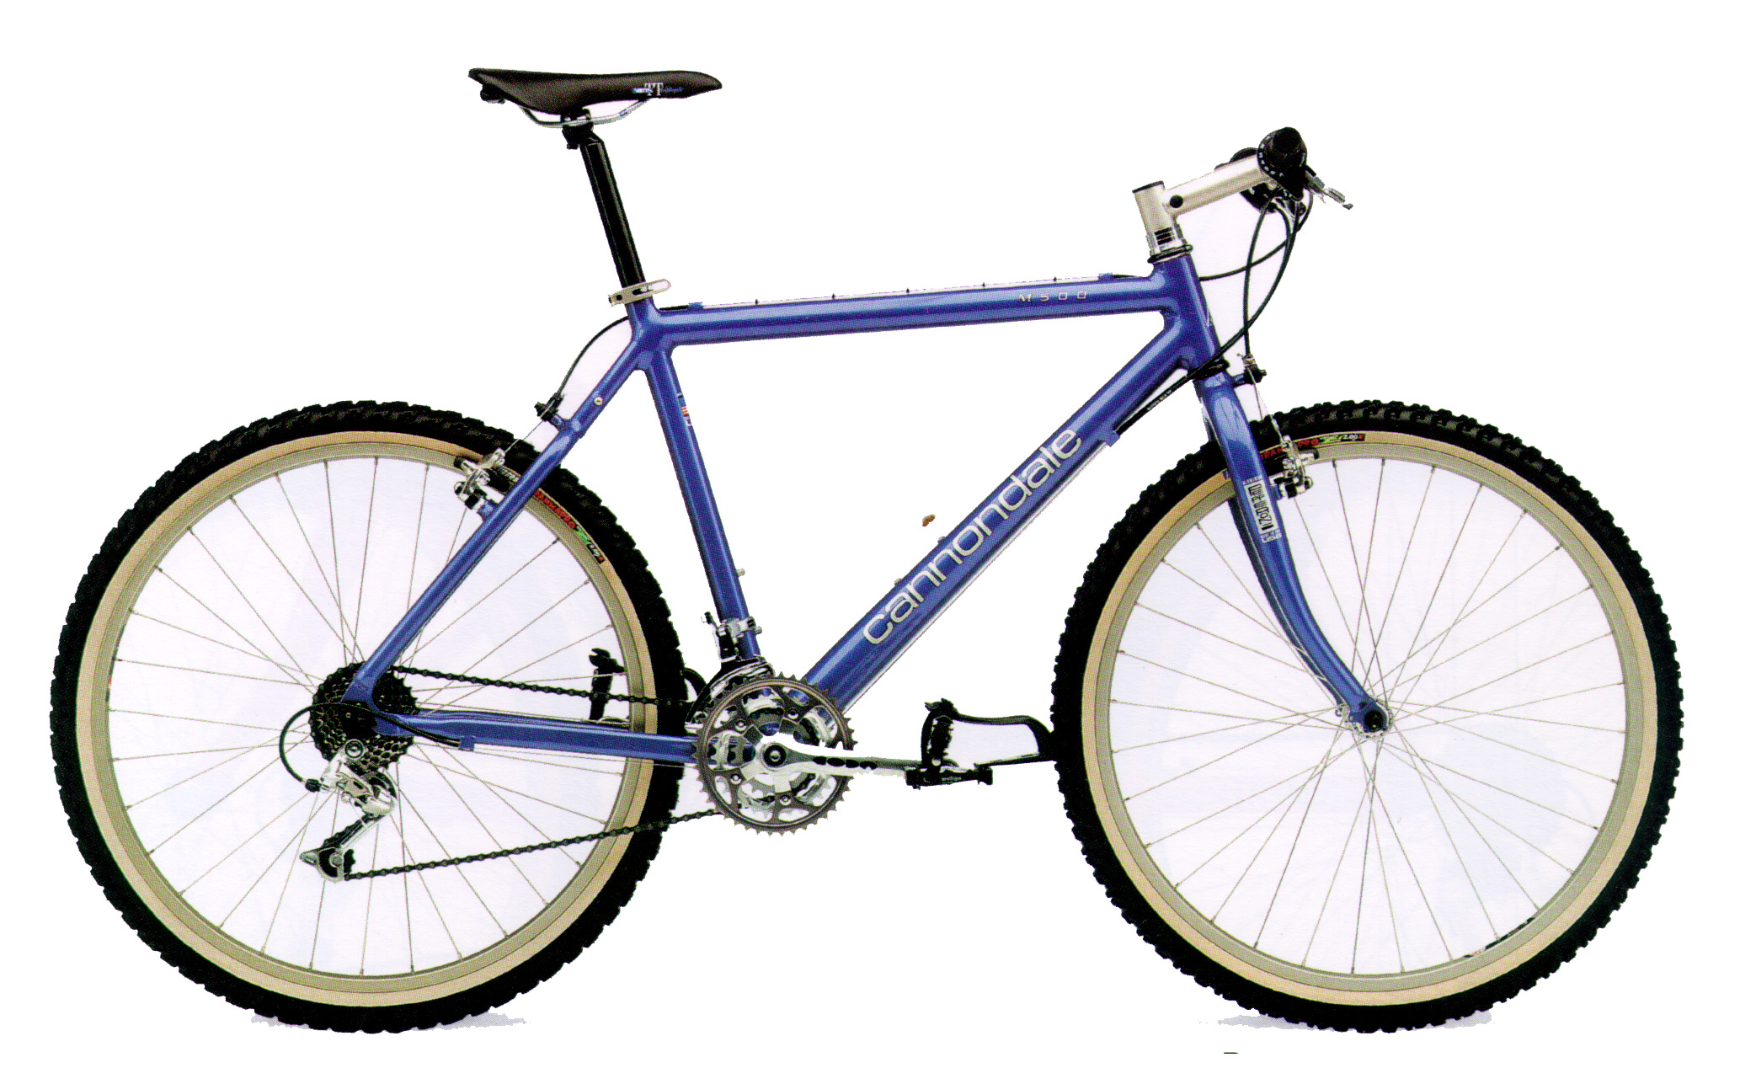
Distance to the airport from here?
Notes:
What is the distance from here to the airport?
How long does it take to get there?
Variables – traffic conditions, mode of transportation, weather – all make a huge difference in the time it takes to arrive, yet the distance remains constant.
Same with writing software – lots of things affect how long it takes to get to “done” – what are they here? (support, interruptions, meetings, etc.).
So we take a 2-part approach to agile estimating – relative size (effort, complexity) of each story, and how fast we can get work done.
We will look at relative size first.

Slide 5
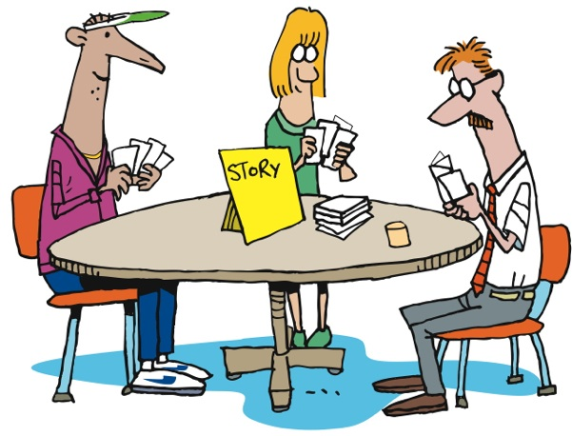
Agile Estimation: Planning Poker
Notes:
How does it work?
First the BA presents the story to the team.
Then everyone thinks about the estimate [CLICK]
Then everyone throws their estimate at the same time
No one is influenced by anyone else [CLICK]
There may be outliers [CLICK]
There is discussion about the outliers [CLICK]
Everyone re-thinks [CLICK]
Then re-throw
Sometimes necessary, sometimes not
----------------------------------------------------------------------------------------------------------------
Let’s look at how it’s done…
First, we gain a clear understanding of the story, including the acceptance criteria and the tasks needed to complete the story. Once all members of the team feel that they have that understanding, each member of the team selects the number that they feel represents the relative complexity of the story, as compared to other stories that the team has implemented.
As a group, [CLICK] team members reveal their estimates – the numbers they have chosen, that is. Revealing all at once prevents any team member from being influenced by another team member’s estimate.
It’s not unusual for there to be outliers [CLICK] – estimates that are different from the majority. When this happens, [CLICK] the team discusses the differences. Some will have thought of other tasks, or understood the tasks differently. Sometimes it’s QA who sees things differently. [CLICK]
Regardless, after discussing things, the team [CLICK] estimates again. If it takes more than three rounds of estimating, there’s a smell that needs to be addressed. The story may need to be rewritten or more analysis may need to be done.
Of course, sometimes the people who have thrown the outliers will agree to change their estimates without another round of estimating, once they understand the thinking of their teammates. In this case, no additional rounds of Planning Poker are needed for that story.

Slide 6
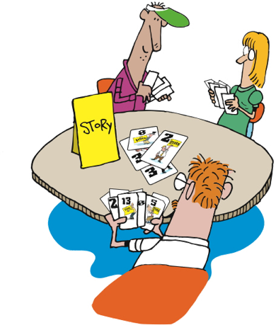
Agile Estimation: Planning Poker
Notes:
How does it work?
First the BA presents the story to the team.
Then everyone thinks about the estimate [CLICK]
Then everyone throws their estimate at the same time
No one is influenced by anyone else [CLICK]
There may be outliers [CLICK]
There is discussion about the outliers [CLICK]
Everyone re-thinks [CLICK]
Then re-throw
Sometimes necessary, sometimes not
----------------------------------------------------------------------------------------------------------------
Let’s look at how it’s done…
First, we gain a clear understanding of the story, including the acceptance criteria and the tasks needed to complete the story. Once all members of the team feel that they have that understanding, each member of the team selects the number that they feel represents the relative complexity of the story, as compared to other stories that the team has implemented.
As a group, [CLICK] team members reveal their estimates – the numbers they have chosen, that is. Revealing all at once prevents any team member from being influenced by another team member’s estimate.
It’s not unusual for there to be outliers [CLICK] – estimates that are different from the majority. When this happens, [CLICK] the team discusses the differences. Some will have thought of other tasks, or understood the tasks differently. Sometimes it’s QA who sees things differently. [CLICK]
Regardless, after discussing things, the team [CLICK] estimates again. If it takes more than three rounds of estimating, there’s a smell that needs to be addressed. The story may need to be rewritten or more analysis may need to be done.
Of course, sometimes the people who have thrown the outliers will agree to change their estimates without another round of estimating, once they understand the thinking of their teammates. In this case, no additional rounds of Planning Poker are needed for that story.

Slide 7
Agile Estimation
Discuss only if there is disagreement
If everyone agrees, then there is no need to discuss
Discuss the unknowns – “Why do you think it’s a…”
Don’t try to convince people to change
Re-throw
Notes:
This variation is one that we have used. We throw 1, 2, or 3 as valid estimates. 5 is NOT a valid estimate and means “I have no idea”. If someone throws that then we need to have a conversation.
Teams may have their own variations on this. Sometimes people can abstain by throwing “rock” (a fist).
Note: demonstrate to them the counting in strategy you will use! “One, two, three, throw!”
From Martin Fowler’s website: http://martinfowler.com/bliki/ThrownEstimate.html

Slide 8
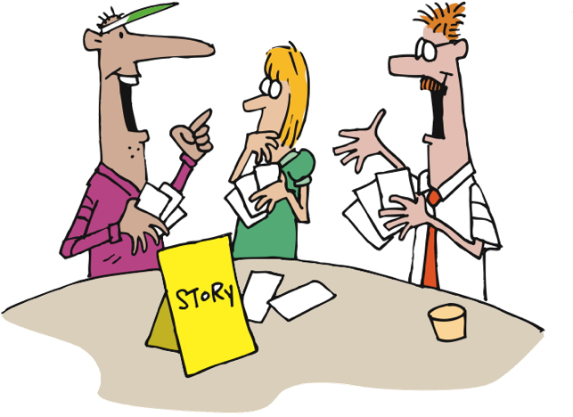
Agile Estimation: Planning Poker
Notes:
How does it work?
First the BA presents the story to the team.
Then everyone thinks about the estimate [CLICK]
Then everyone throws their estimate at the same time
No one is influenced by anyone else [CLICK]
There may be outliers [CLICK]
There is discussion about the outliers [CLICK]
Everyone re-thinks [CLICK]
Then re-throw
Sometimes necessary, sometimes not
----------------------------------------------------------------------------------------------------------------
Let’s look at how it’s done…
First, we gain a clear understanding of the story, including the acceptance criteria and the tasks needed to complete the story. Once all members of the team feel that they have that understanding, each member of the team selects the number that they feel represents the relative complexity of the story, as compared to other stories that the team has implemented.
As a group, [CLICK] team members reveal their estimates – the numbers they have chosen, that is. Revealing all at once prevents any team member from being influenced by another team member’s estimate.
It’s not unusual for there to be outliers [CLICK] – estimates that are different from the majority. When this happens, [CLICK] the team discusses the differences. Some will have thought of other tasks, or understood the tasks differently. Sometimes it’s QA who sees things differently. [CLICK]
Regardless, after discussing things, the team [CLICK] estimates again. If it takes more than three rounds of estimating, there’s a smell that needs to be addressed. The story may need to be rewritten or more analysis may need to be done.
Of course, sometimes the people who have thrown the outliers will agree to change their estimates without another round of estimating, once they understand the thinking of their teammates. In this case, no additional rounds of Planning Poker are needed for that story.

Slide 9

Agile Estimation: Planning Poker
Notes:
How does it work?
First the BA presents the story to the team.
Then everyone thinks about the estimate [CLICK]
Then everyone throws their estimate at the same time
No one is influenced by anyone else [CLICK]
There may be outliers [CLICK]
There is discussion about the outliers [CLICK]
Everyone re-thinks [CLICK]
Then re-throw
Sometimes necessary, sometimes not
----------------------------------------------------------------------------------------------------------------
Let’s look at how it’s done…
First, we gain a clear understanding of the story, including the acceptance criteria and the tasks needed to complete the story. Once all members of the team feel that they have that understanding, each member of the team selects the number that they feel represents the relative complexity of the story, as compared to other stories that the team has implemented.
As a group, [CLICK] team members reveal their estimates – the numbers they have chosen, that is. Revealing all at once prevents any team member from being influenced by another team member’s estimate.
It’s not unusual for there to be outliers [CLICK] – estimates that are different from the majority. When this happens, [CLICK] the team discusses the differences. Some will have thought of other tasks, or understood the tasks differently. Sometimes it’s QA who sees things differently. [CLICK]
Regardless, after discussing things, the team [CLICK] estimates again. If it takes more than three rounds of estimating, there’s a smell that needs to be addressed. The story may need to be rewritten or more analysis may need to be done.
Of course, sometimes the people who have thrown the outliers will agree to change their estimates without another round of estimating, once they understand the thinking of their teammates. In this case, no additional rounds of Planning Poker are needed for that story.

Slide 10
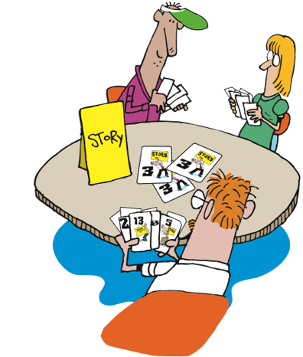
Agile Estimation: Planning Poker
Notes:
How does it work?
First the BA presents the story to the team.
Then everyone thinks about the estimate [CLICK]
Then everyone throws their estimate at the same time
No one is influenced by anyone else [CLICK]
There may be outliers [CLICK]
There is discussion about the outliers [CLICK]
Everyone re-thinks [CLICK]
Then re-throw
Sometimes necessary, sometimes not
----------------------------------------------------------------------------------------------------------------
Let’s look at how it’s done…
First, we gain a clear understanding of the story, including the acceptance criteria and the tasks needed to complete the story. Once all members of the team feel that they have that understanding, each member of the team selects the number that they feel represents the relative complexity of the story, as compared to other stories that the team has implemented.
As a group, [CLICK] team members reveal their estimates – the numbers they have chosen, that is. Revealing all at once prevents any team member from being influenced by another team member’s estimate.
It’s not unusual for there to be outliers [CLICK] – estimates that are different from the majority. When this happens, [CLICK] the team discusses the differences. Some will have thought of other tasks, or understood the tasks differently. Sometimes it’s QA who sees things differently. [CLICK]
Regardless, after discussing things, the team [CLICK] estimates again. If it takes more than three rounds of estimating, there’s a smell that needs to be addressed. The story may need to be rewritten or more analysis may need to be done.
Of course, sometimes the people who have thrown the outliers will agree to change their estimates without another round of estimating, once they understand the thinking of their teammates. In this case, no additional rounds of Planning Poker are needed for that story.

Slide 11
Agile Estimation: Planning Poker
0 + 1 = 1
1 + 1 = 2
1 + 2 = 3
2 + 3 = 5
3 + 5 = 8
5 + 8 = 13
8 + 13 = 21
Notes:
Various systems of estimates used
We use the Fibonacci Sequence
Documented by Leonardo Pisano Bogollo aka Leonardo Fibonacci
Perhaps the most talented mathematician of the middle ages
Each number is the sum of the previous 2 [CLICK]
Teams usually define what system they will use. 1,2,3,5, 8
------------------------------------------------------------------------------------------------------------------
There are various systems of estimation used, when applying Planning Poker. We use the Fibonacci Sequence numbers. The Fibonacci Sequence was documented by Leonardo Pisano Bogollo, also known as Leonardo Fibonacci, who was considered to be perhaps the most talented mathematician of the Middle Ages.
In the Fibonacci sequence, each number is the sum of the previous two numbers, starting with 0 and 1. Thus the sequence begins 0, 1, 1, 2, 3, 5, 8, 13, 21, 34
For Planning Poker, we use 0, 1, 2, 3, 5, 8, and 13. Some include 20 and 40 and 100 in our planning poker decks, in order to indicate that a story is too large to be done in a single iteration.

Slide 12

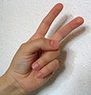
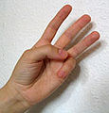

Agile Estimation: Thrown Estimates
Like “Rock Paper Scissors”
Use finger counting
Everyone “throws” their estimate after a count of 3
“One, two, three, Throw!”
Can estimate 1, 2, 3, or 5
1
2
3
?
http://martinfowler.com/bliki/ThrownEstimate.html
Notes:
This variation is one that we have used. We throw 1, 2, or 3 as valid estimates. 5 is NOT a valid estimate and means “I have no idea”. If someone throws that then we need to have a conversation.
Teams may have their own variations on this. Sometimes people can abstain by throwing “rock” (a fist).
Note: demonstrate to them the counting in strategy you will use! “One, two, three, throw!”
From Martin Fowler’s website: http://martinfowler.com/bliki/ThrownEstimate.html

Slide 13
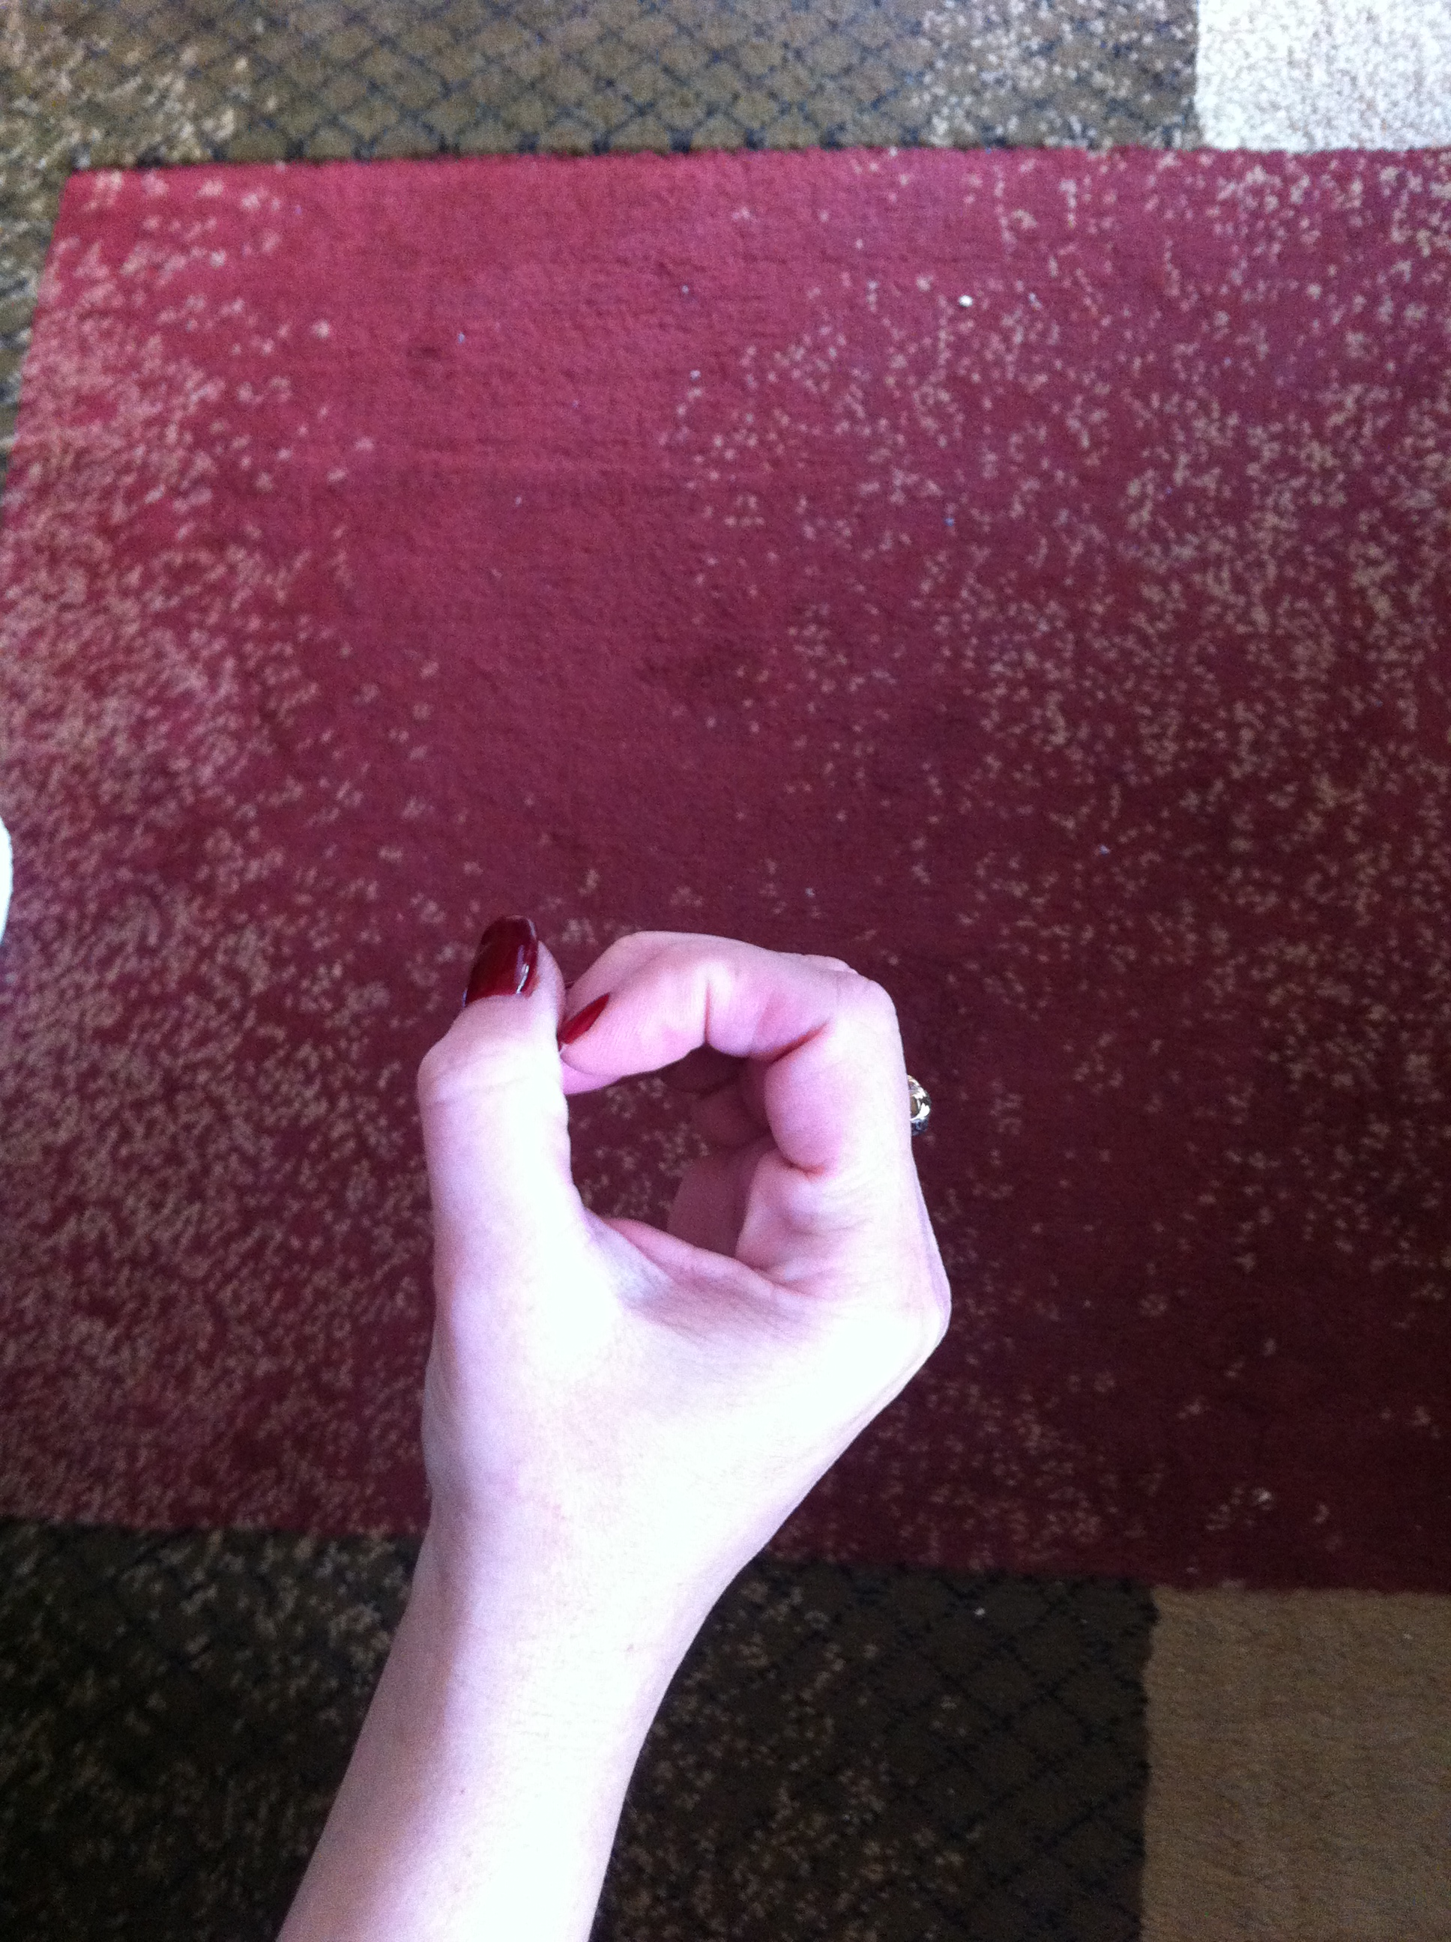
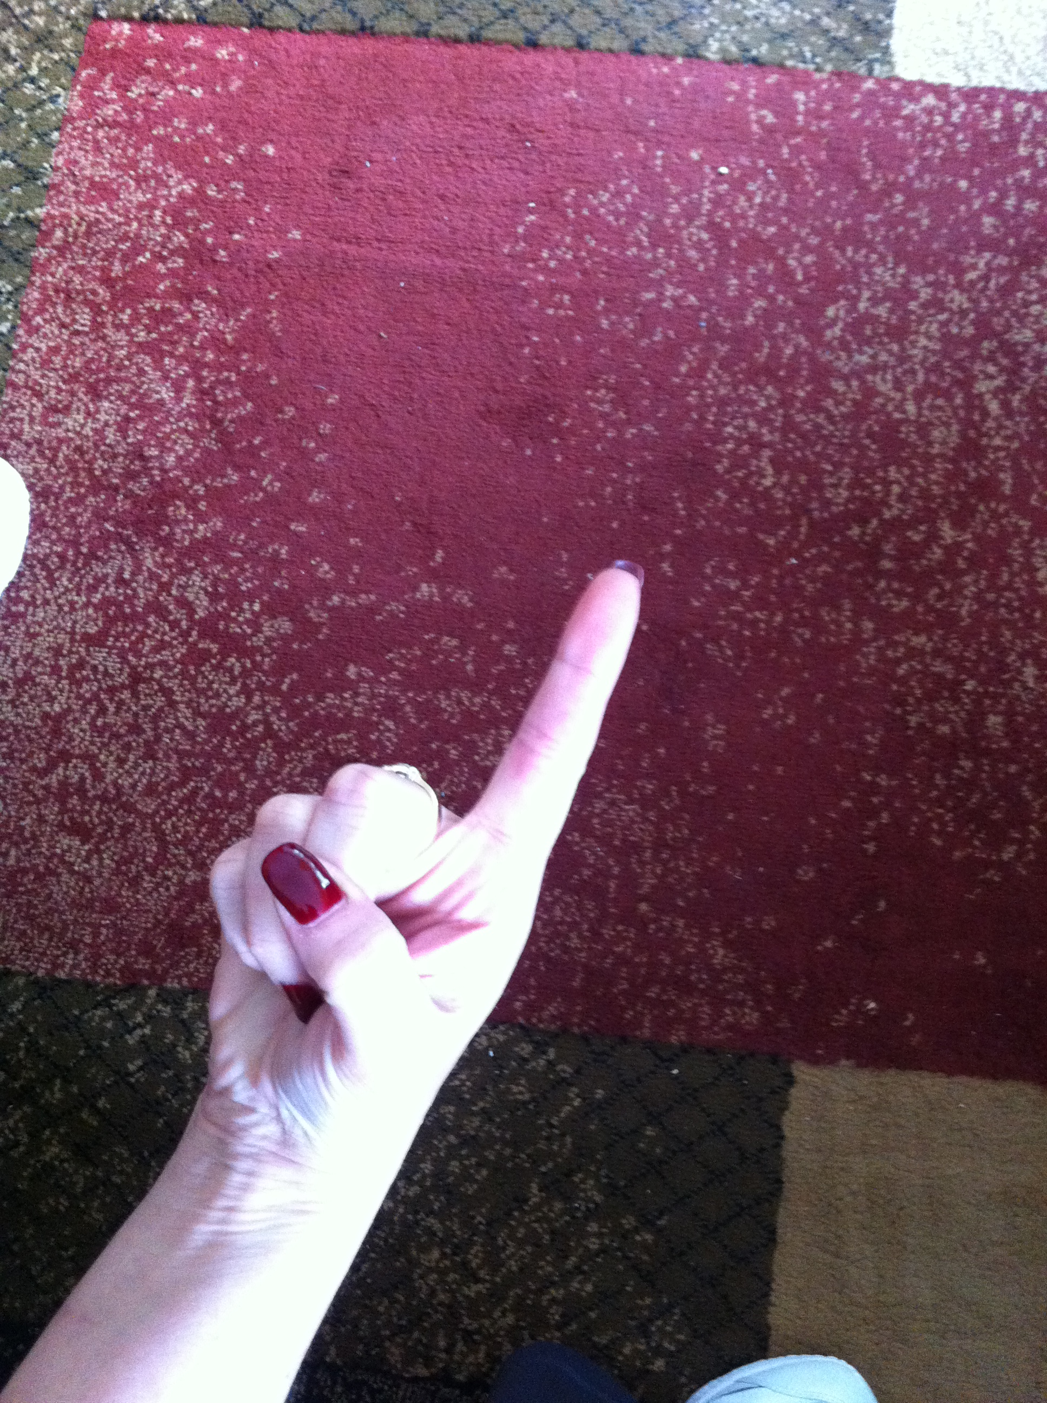
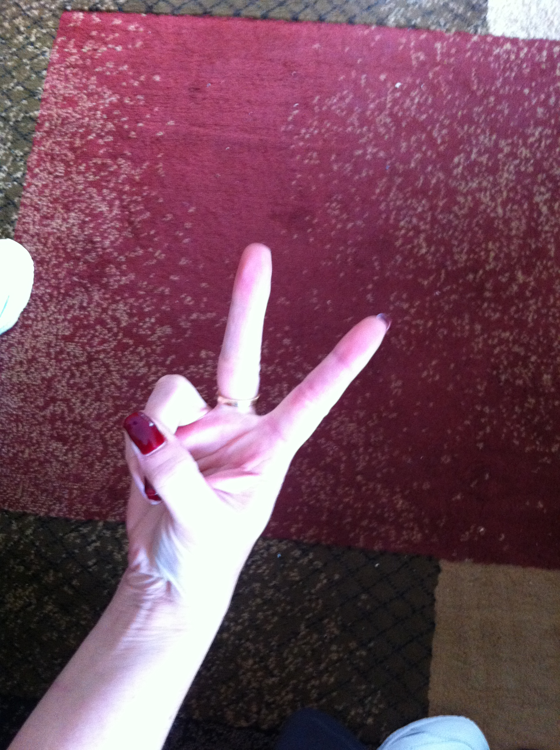
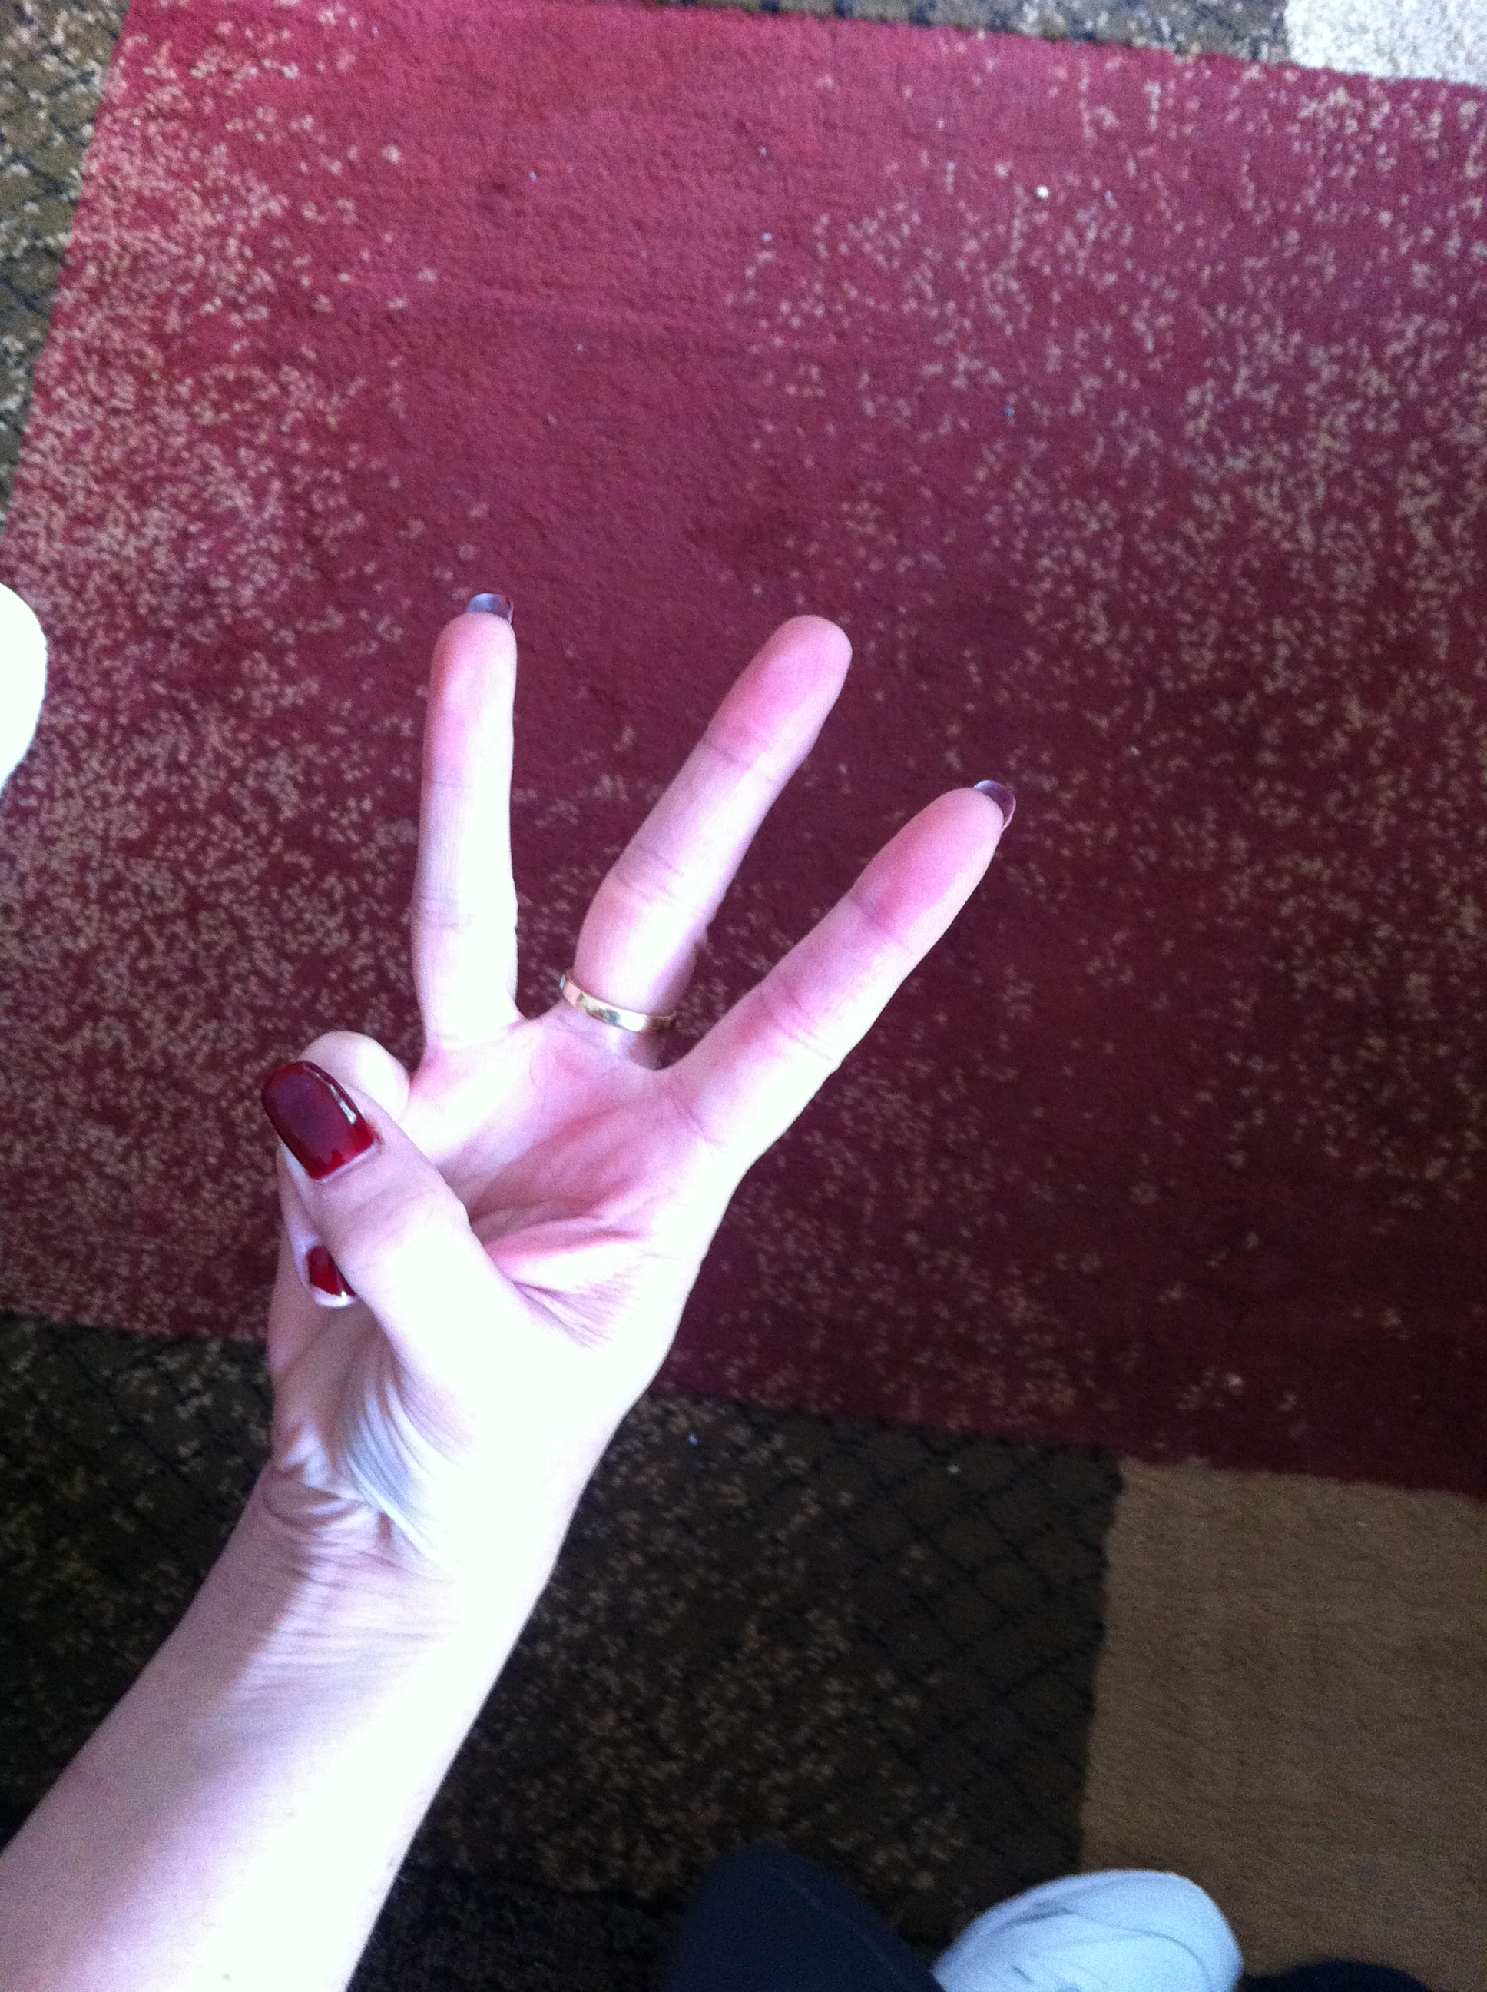
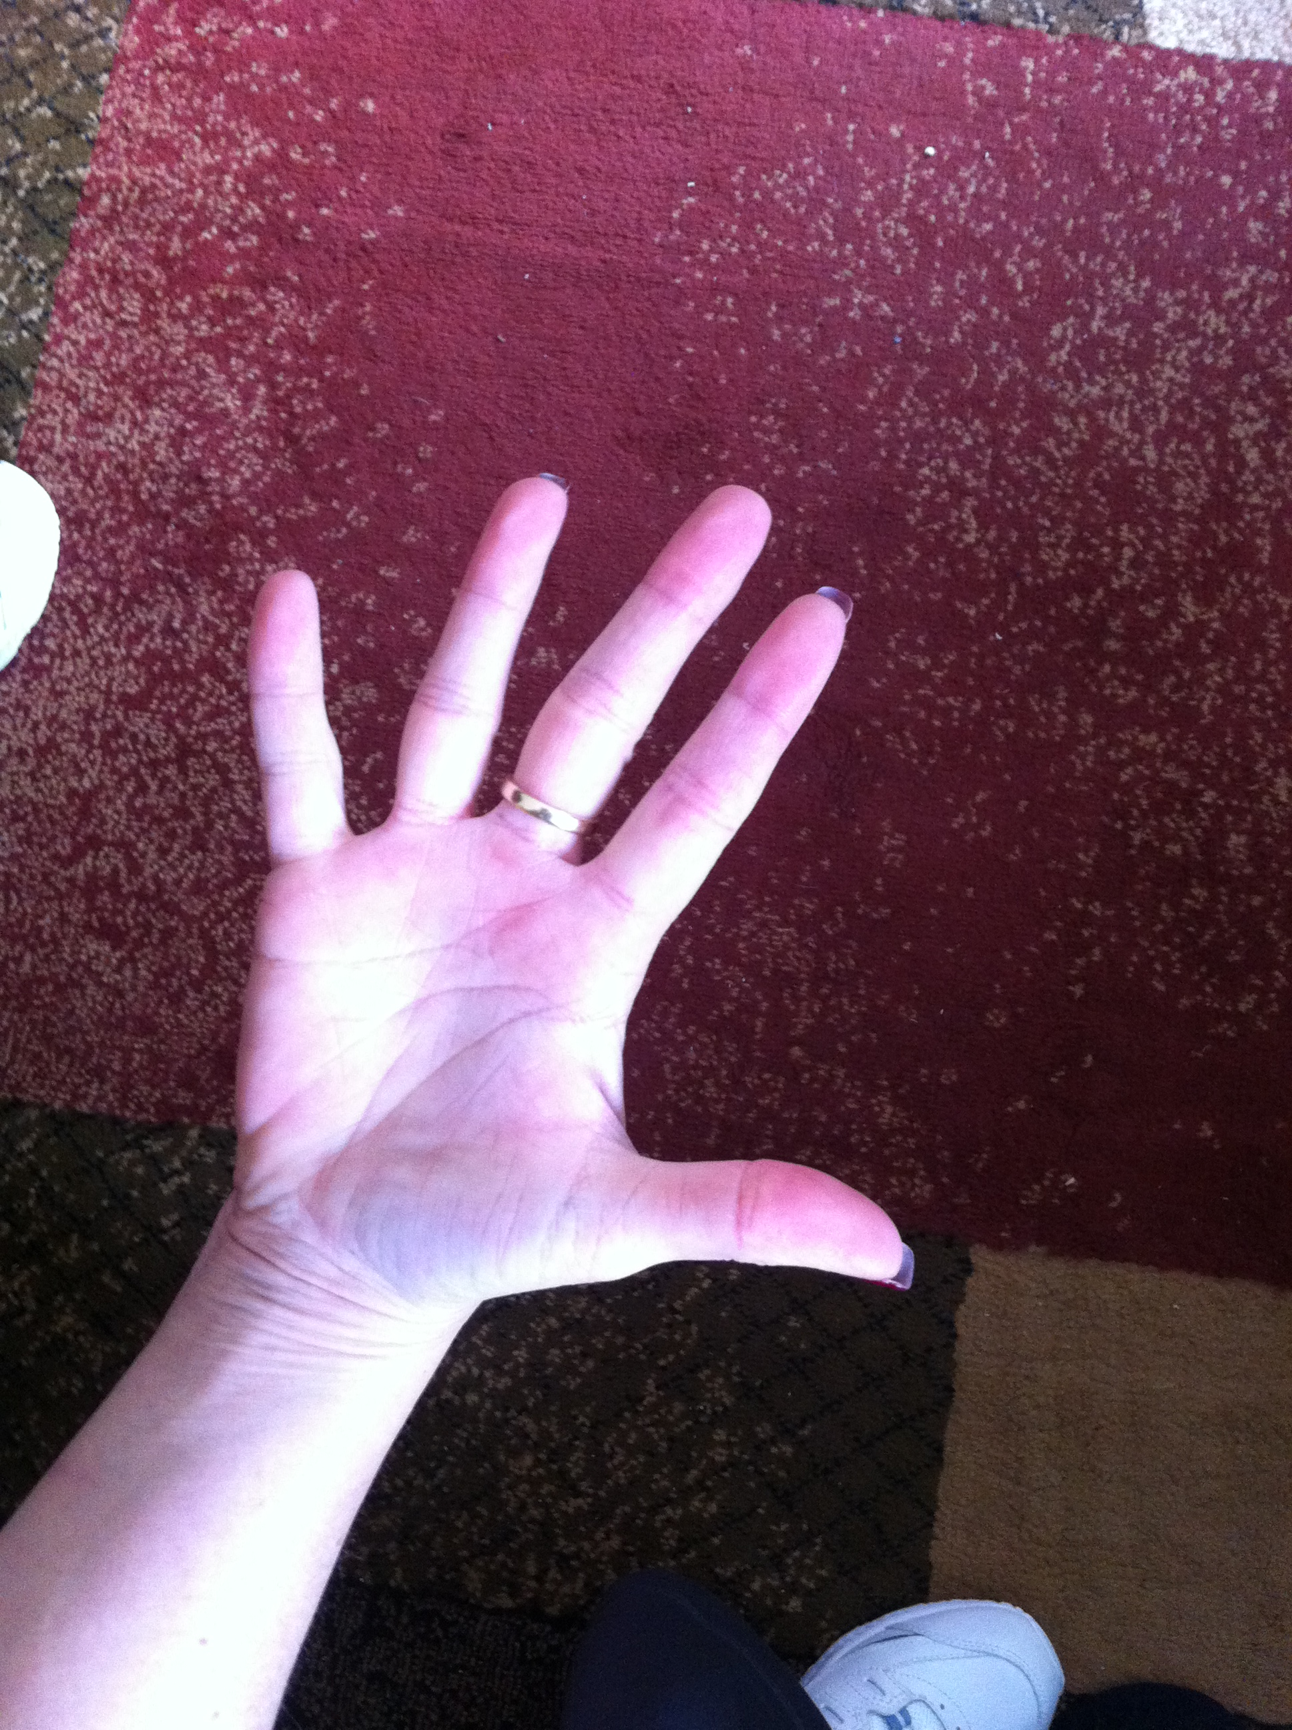
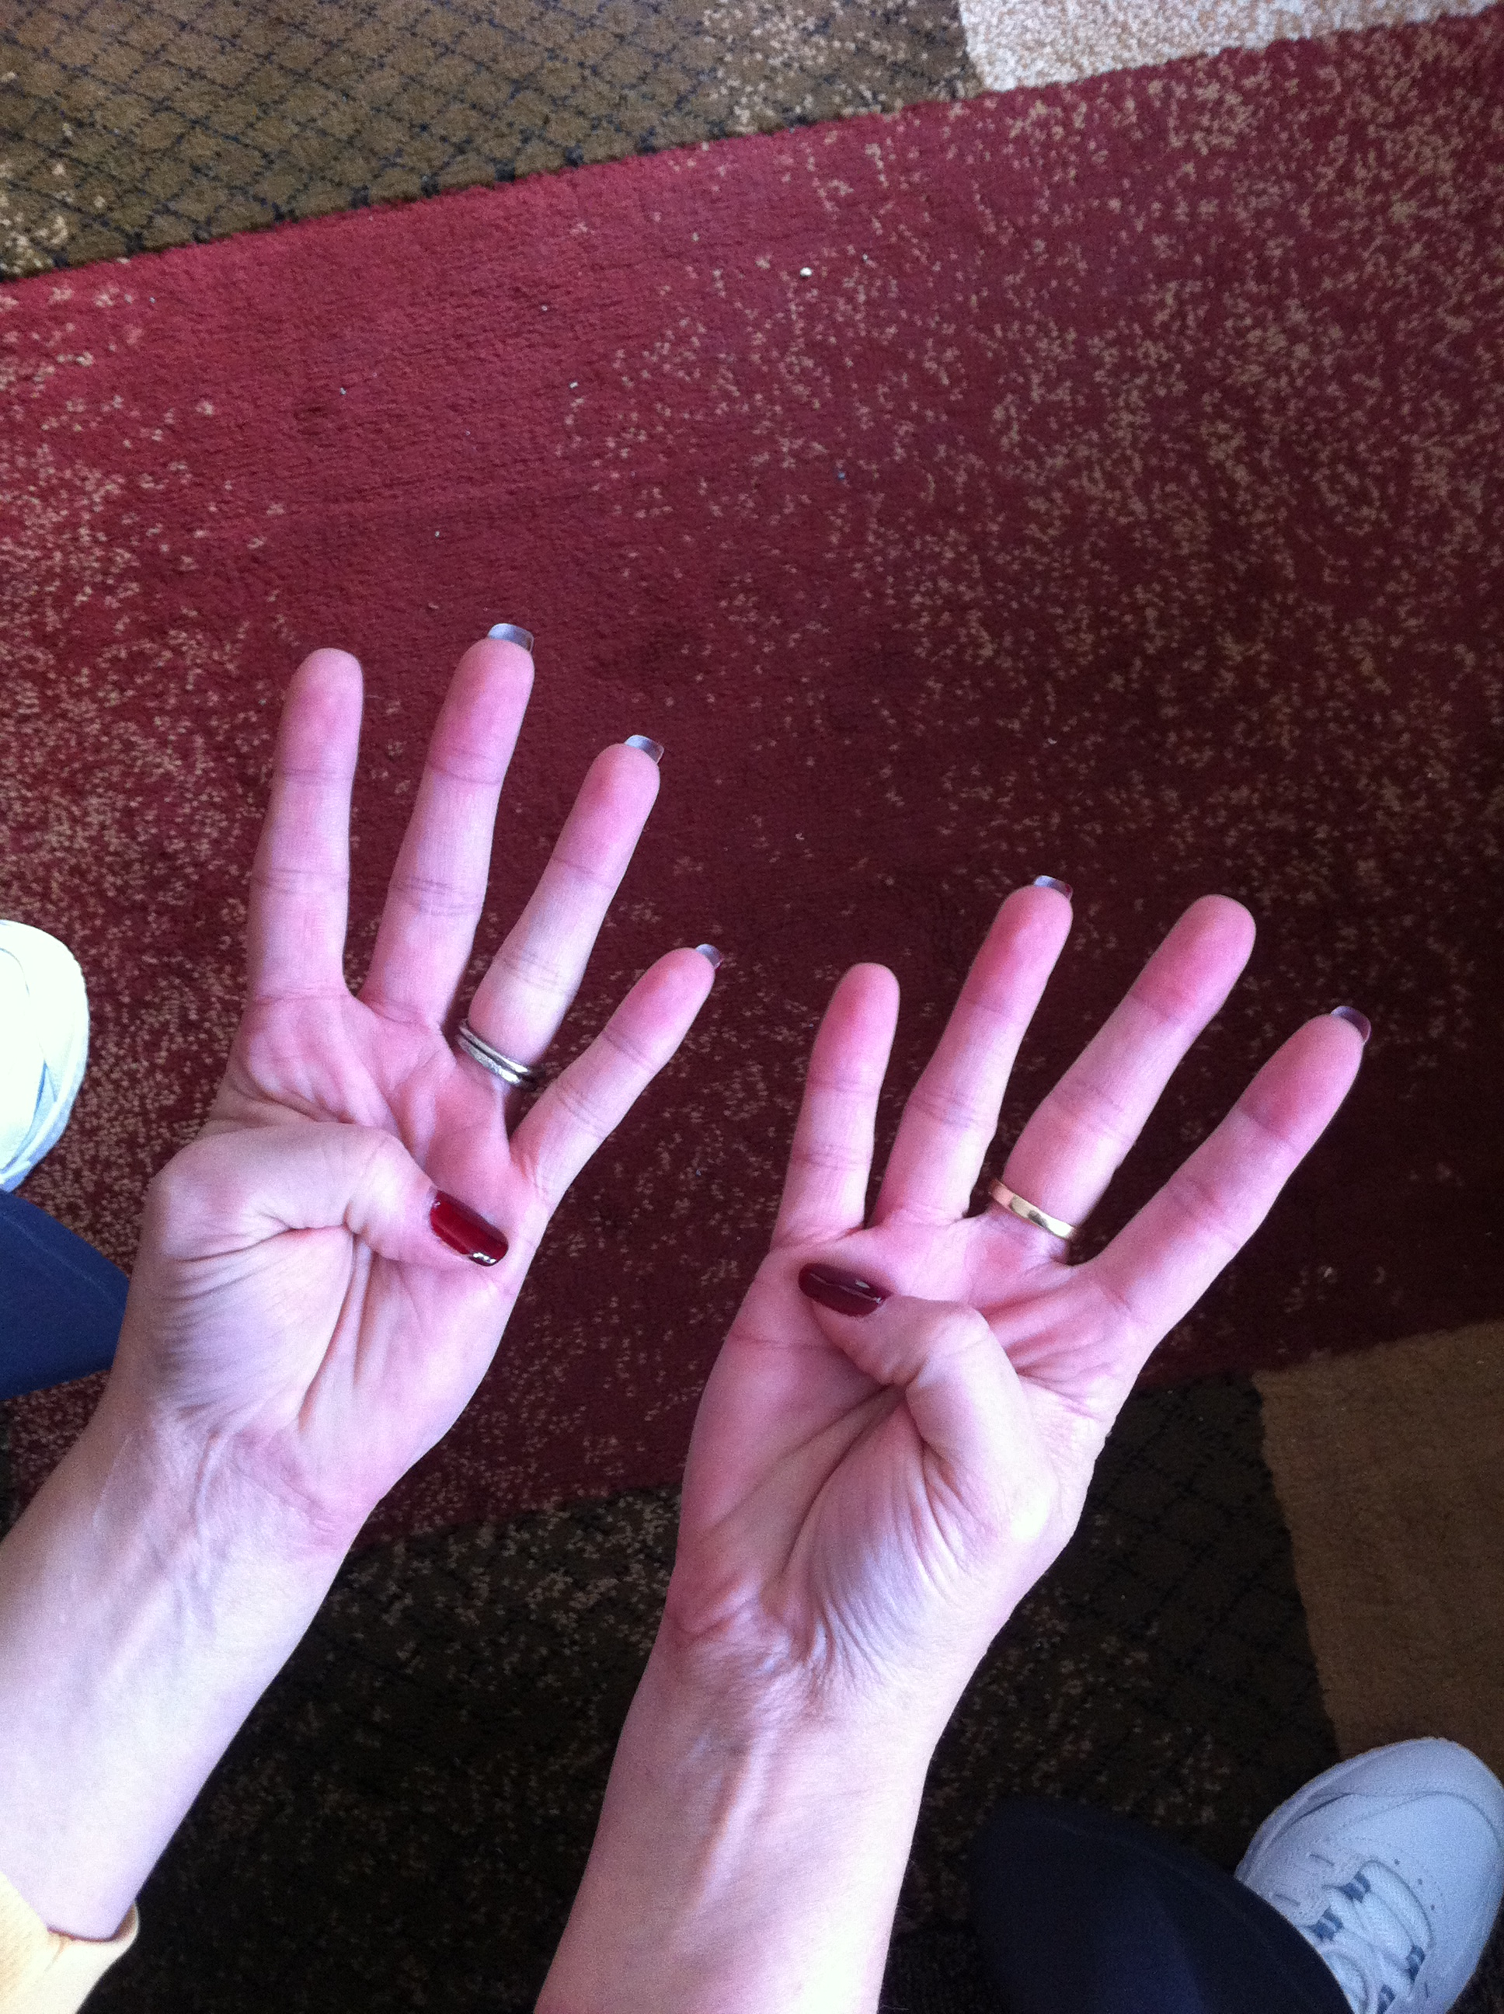
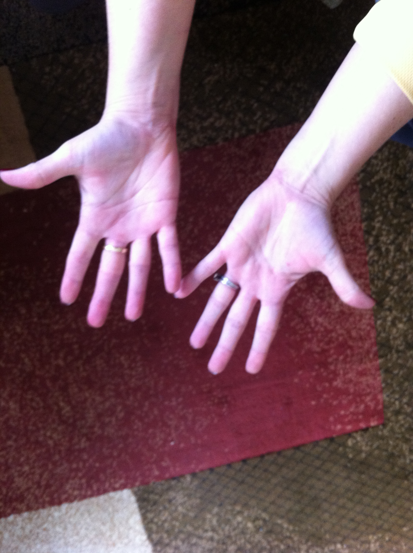
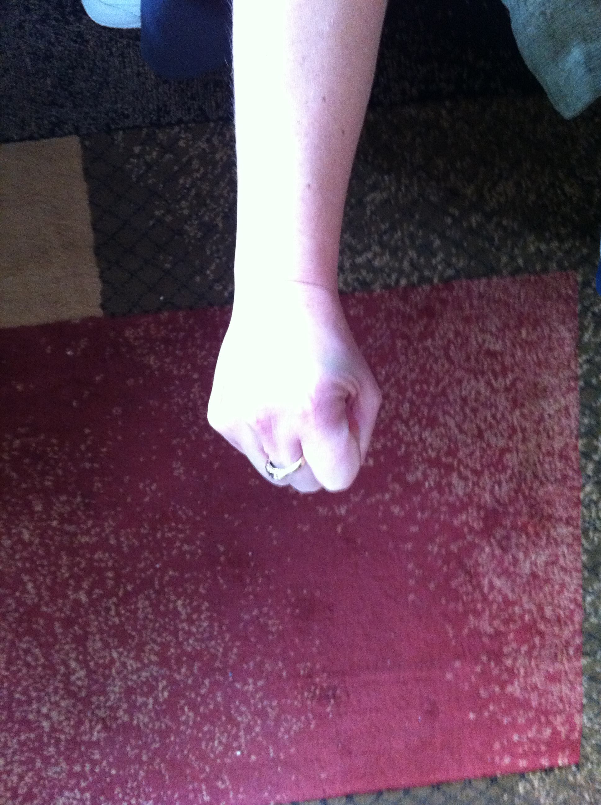
Agile Estimation: Thrown Estimates
Zero
1
2
3
5
8
10
Don’t know

Slide 14
Agile Estimation: Thrown Estimates
10 often means “too big” or “too many unknowns”
Discuss the unknowns
Individuals without much knowledge can abstain
Re-throw
Notes:
This variation is one that we have used. We throw 1, 2, or 3 as valid estimates. 5 is NOT a valid estimate and means “I have no idea”. If someone throws that then we need to have a conversation.
Teams may have their own variations on this. Sometimes people can abstain by throwing “rock” (a fist).
Note: demonstrate to them the counting in strategy you will use! “One, two, three, throw!”
From Martin Fowler’s website: http://martinfowler.com/bliki/ThrownEstimate.html

Slide 15
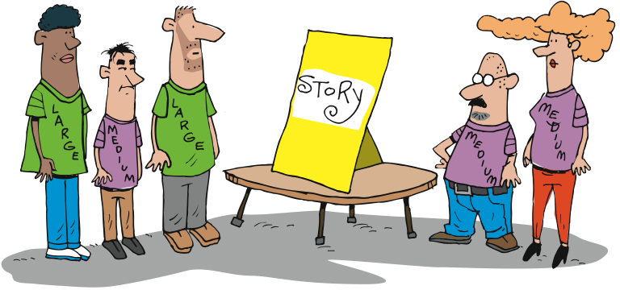
Agile Estimation: Tee Shirts
Notes:
T-shirt sizing is sometimes used as a starting point
Will need to be translated to time at some point
Helpful when thinking about a new module or initially sizing a project
----------------------------------------------------------------------
Another simple method of relative estimation is T-shirt sizing. The simplest is to estimate each story as small, medium, or large. You can include extra small, extra large, and extra extra large if you like. Any system that estimates stories relative to other stories will work.

Slide 16
Relative Sizing Tips
All stories are sized relative to another
Sort out the stories and find the smallest
Size all other stories relative to that one.
Twice as big, three times as big, etc

Slide 17
Relative Sizing Stories
Using the stories you wrote for your animal
Size the stories relative to each based on….
The effort it would take to develop this story
Note any assumptions you are making
It’s the team getting it to “done”
Notes:
About 20 minutes – great if they can estimate all their stories, but not absolutely necessary

Slide 18

Spikes
Solve hard technical problems through real experiments… without tampering with production code
Notes:
Were there any problems? Anything you didn’t know when you came to estimate?
This is where we do some more work – research – to allow us to better understand the story.
Time boxed
Throw away
Done during inception, but typically environments are set up yet
Done during Iteration 0, but initial estimate has already been given

Slide 19
How much can we do?
Notes:
Low: 1min
High: 3min

Slide 20
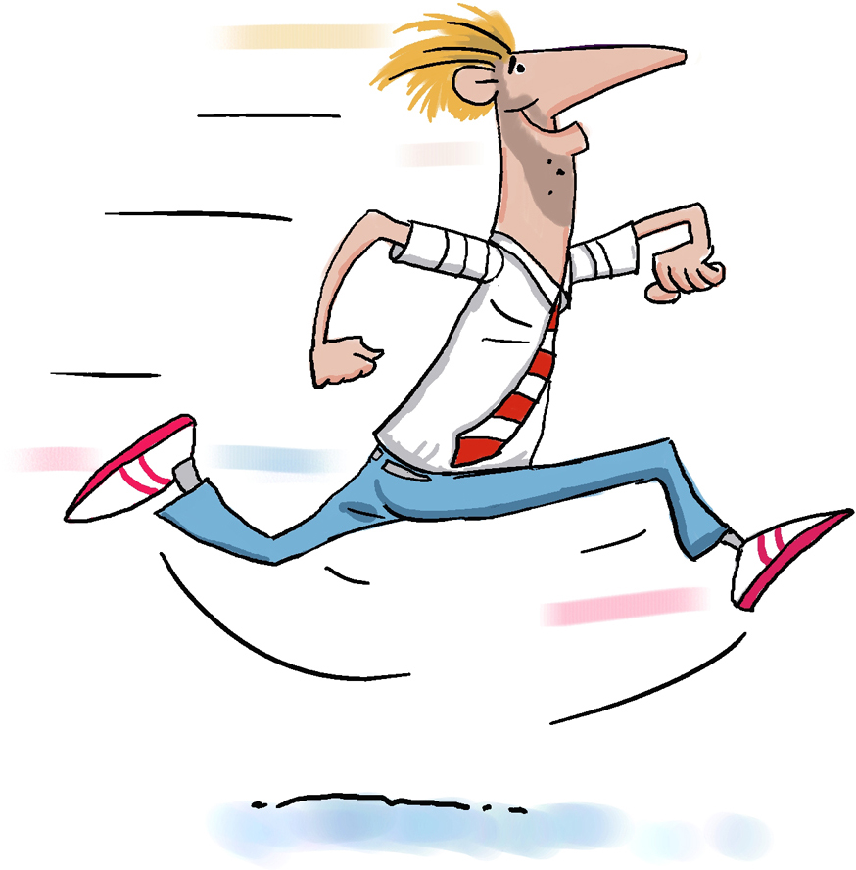
Velocity
Notes:
Now we need to figure out how fast we think we can work
Initially it’s a guess. Experience makes our guesses more accurate and precise.
Velocity – the amount of work that we can complete in an iteration
-----------------------------------------------------------------------------------------------------------
Once we’ve figured out how difficult each of our stories is, then we need to figure out how many we can fit into an Iteration. That’s what we call velocity – the amount of work, computed based on our estimates, that will fit in an Iteration.

Slide 21
How to Derive a Planning Velocity
Trial Iterations
Educated Guess
Experience
Velocity Planning Games
Accuracy
Effort/Time
Notes:
The line represents project start.
Educated guess using data from previous projects is risky. You must determine the variables that were in play on the other project(s) compared to this project.
Trial iteration. Costly, but most accurate for planning.
Velocity planning game. More risky. Likely to be modified.
---------------------------------------------------------------------------------------------------------------
Experienced Agile teams will set expectations for a fairly steady ramp up in velocity over time as the team forms and early uncertainties get ironed out. But the question remains – what planning velocity shall we ramp up to? As with all estimation activities, experience is an invaluable contributor but hard data is going to be the biggest factor, hence the option of using a trial iteration. As heavyweight as this sounds, taking just two weeks to provide a good set of real data for future planning over the course of a 20 week project is probably not a bad investment.
For people looking for a cheap way of obtaining a planning velocity, do be wary of using an data from previous projects, even with the same group of people. As easy as this may sound, there are so many variables unaccounted for that any planning you do is really little more than an educated guess.
Low: 1 min
High: 3 min

Slide 22
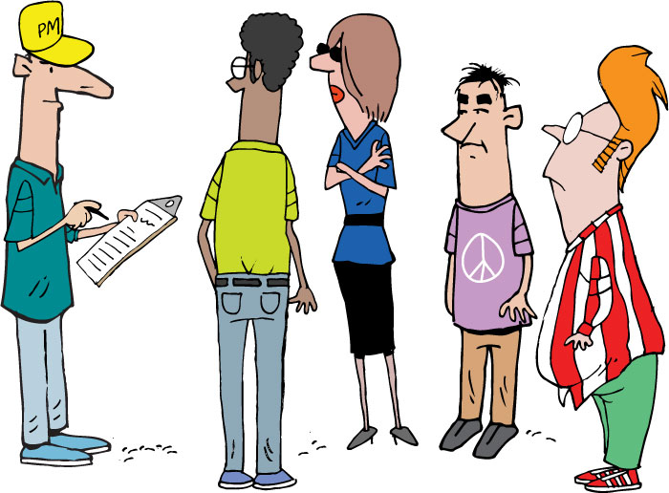
Velocity Planning Game
Devs select cards they think a pair can get “done” within an iteration
Facilitator tallies up the total (secretly)
Facilitator lays out sampling of stories
Team should decide in advance on:
Length of iteration
Definition of “done”
After a min of 10 iterations, look for convergence
Notes:
Low: 2 min
High: 4 min

Slide 23
5
3
8
1
2
2
2
3
3
5
1
8
Notes:
We take our estimated stories [CLICK]
…something we call the Raw Velocity Game.
In the Raw Velocity Game, the goal is to estimate our initial “raw” velocity, so that we can know how many stories to choose for our first Iterations.
We start with all of our stories [CLICK] and their estimates. Then we cover all the estimates [CLICK].

Slide 24
5
3
8
1
2
2
2
3
3
5
1
8
Notes:
We cover up the estimates
We take a random sample of cards and lay them out
We ask the developers which cards they feel could be done in 1 iteration
We calculate the total
We repeat
We average
The team now examines all the stories and chooses a set to answer the question “Pick a set of stories that you think you can get done in one iteration.” The idea is to pick just enough stories to fill an iteration, without overfilling it.
Once the team has picked some stories… [CLICK] pause [NEXT SLIDE]

Slide 25
3
5
8
1
2
2
2
3
Round one: 8
3
5
Round two: 11
Round three: 9
1
8
Average: 9
Notes:
We calculate the total
We repeat
We average
Gives us a starting point
Adjusted throughout the project
Assume lower velocity at the beginning of a project
Team needs to jel
Things the impact velocity
Technology
Delivery model
Team size
Full time/part time devs
----------------------------------------------------------------------------------------------------------
… we reveal the estimates [CLICK] and total them up. [CLICK]
We then repeat this process two more times, getting the team’s best guesses [CLICK], and we average all three rounds [CLICK].
The resulting number – nine in this example – gives us our initial, raw velocity. [CLICK] We’ll use this number to determine how much work we think we can get done in our first few iterations.

Slide 26
Estimate your velocity
Get back into your groups
Use the estimates you developed a few minutes ago
How many stories could you complete in a single iteration?
Notes:
Talk about iteration length here
Are we estimating for a pair, for the entire team, for a single person?

Slide 27
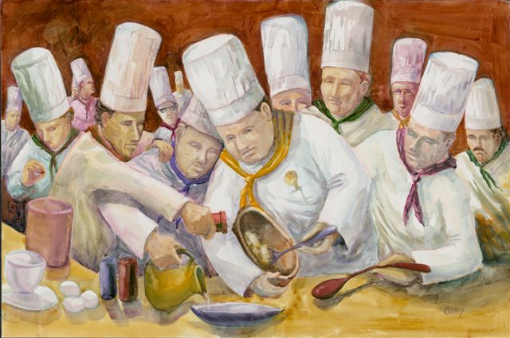
How Many Pairs?
Unfortunately this is often more art than science
But, it will probably be influenced by:
Availability
How many different feature sets/subsystems there are
How many points in the total
Gut feel – “too many cooks in the kitchen”
Notes:
Insert activity here
Without activity:
Low: 1 min
High: 3 min

Slide 28
How long?

Slide 29
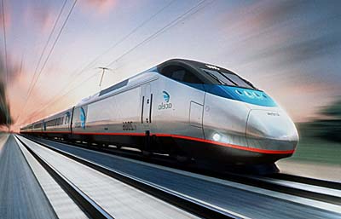
How many iterations?
As a user I need to blah blah so that blah
4
2
Story Point Estimates
As a user I need to blah blah so that blah
As a user I need to blah blah so that blah
4
As a user I need to blah blah so that blah
2
Estimated Iteration Velocity
As a user I need to blah blah so that blah
1
As a user I need to blah blah so that blah
8
User Stories
(Points per iteration)
Total Story Points
/ Estimated Velocity
= Number of Iterations
Notes:
Need to answer the questions of:
How long will it take?
How much will it cost?
Other things can impact velocity, like ramp up, scheduled absences, etc, and should be factored in the plan
Low: 1 min
High: 3 min

Slide 30
Raw Velocity
Estimated Velocity Per Pair X Steady State Pairs = Raw Velocity Per Iteration
POINTS
TIME
Total Story Points / Raw Velocity Per Iteration = Rough Number of Iterations

Slide 31
How long?
Use the story estimates and estimated velocity you developed a few minutes ago
How many iterations will it take you to complete your creature?
Notes:
Talk about iteration length here
Are we estimating for a pair, for the entire team, for a single person?

Slide 32
Velocity Adjustment - Risk
Calculate with lower end of the velocity estimate, or to account for risks
POINTS
TIME

Slide 33
Velocity Adjustment – Ramp Up
Account for the team (as a steady-state whole) will take a couple of iterations to get up to full (estimated) velocity
POINTS
TIME

Slide 34
Velocity Adjustment – Onboarding
Depending on size of team, not all developers may start on the first day. May need to adjust further to match velocity to onboarding.
POINTS
TIME

Slide 35
Velocity Adjustment – Time Off
Make adjustments for known vacations, holidays, business closings, special events
POINTS
TIME

Slide 36
Development Duration Range
The intersection of the story point and velocity lines gives you your development duration range
POINTS
TIME

Slide 37
Add Non-Dev Time
Add whatever time is necessary on either end, and you have your total estimated duration range
UAT
Beta
GA
Initiation
UAT
Beta
GA
POINTS
TIME

Slide 38
Questions?

